Slide 1
Welcome to
Department of mechanical and production engineering

Slide 2
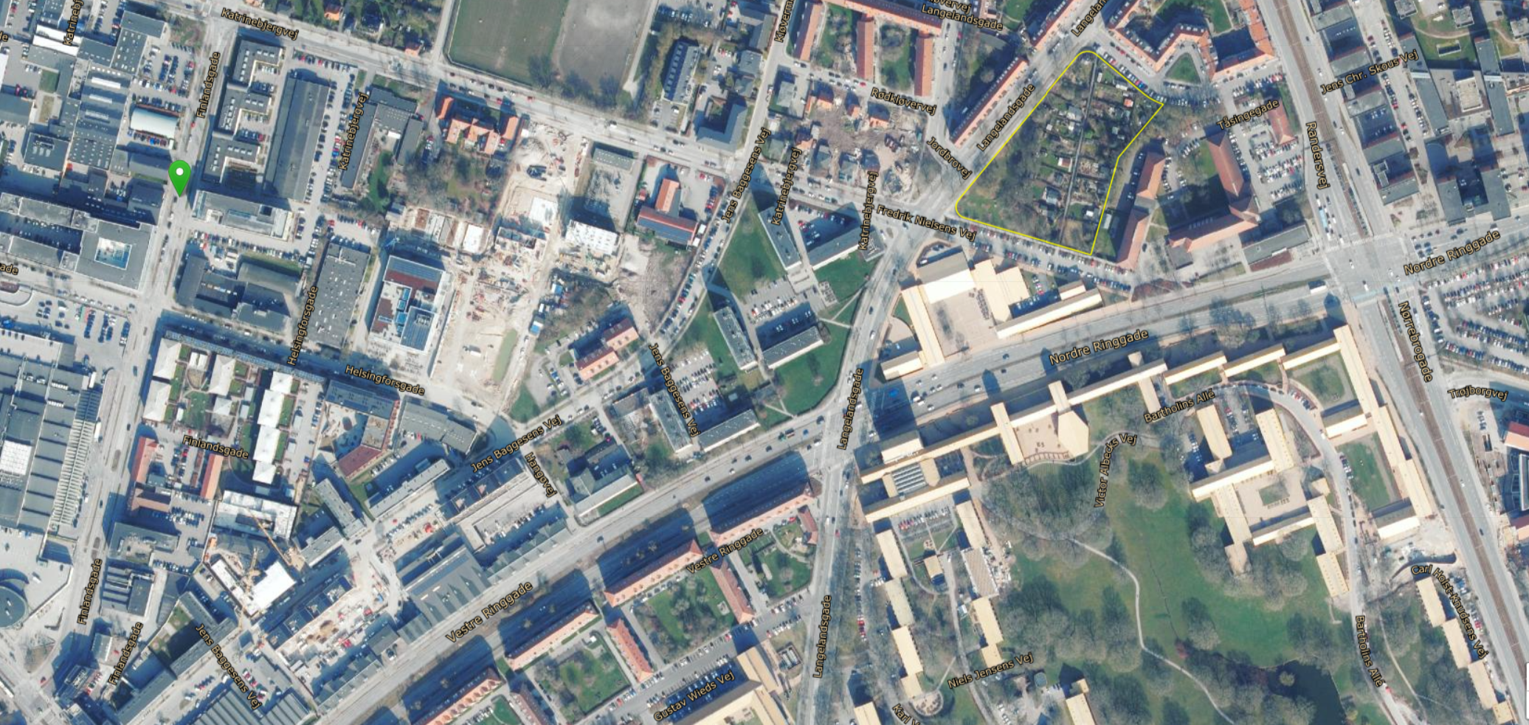
Campus katrinebjerg

Slide 3
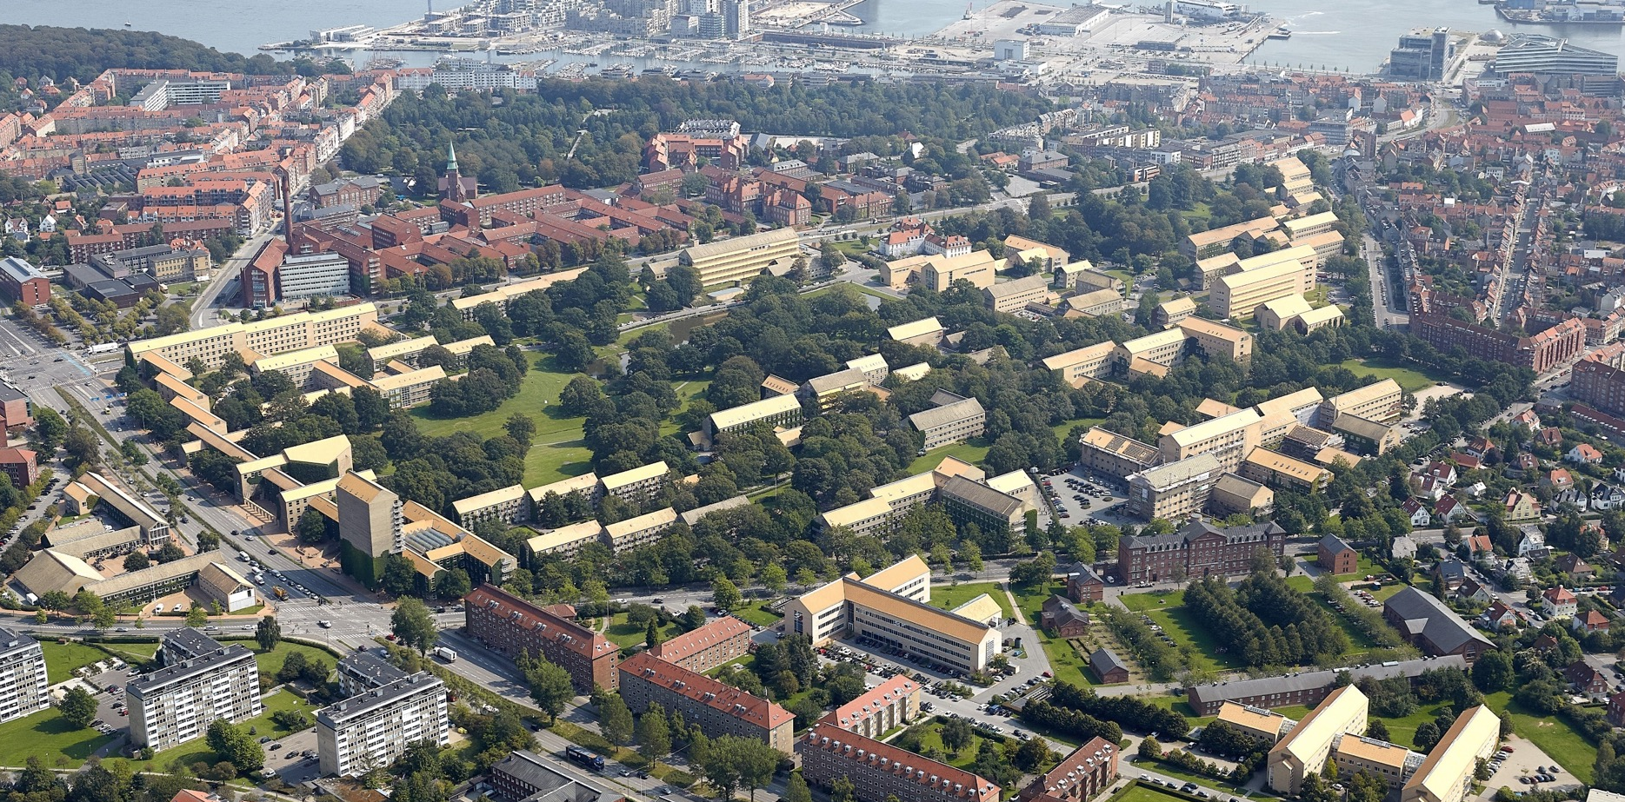
Aarhus university

Slide 4
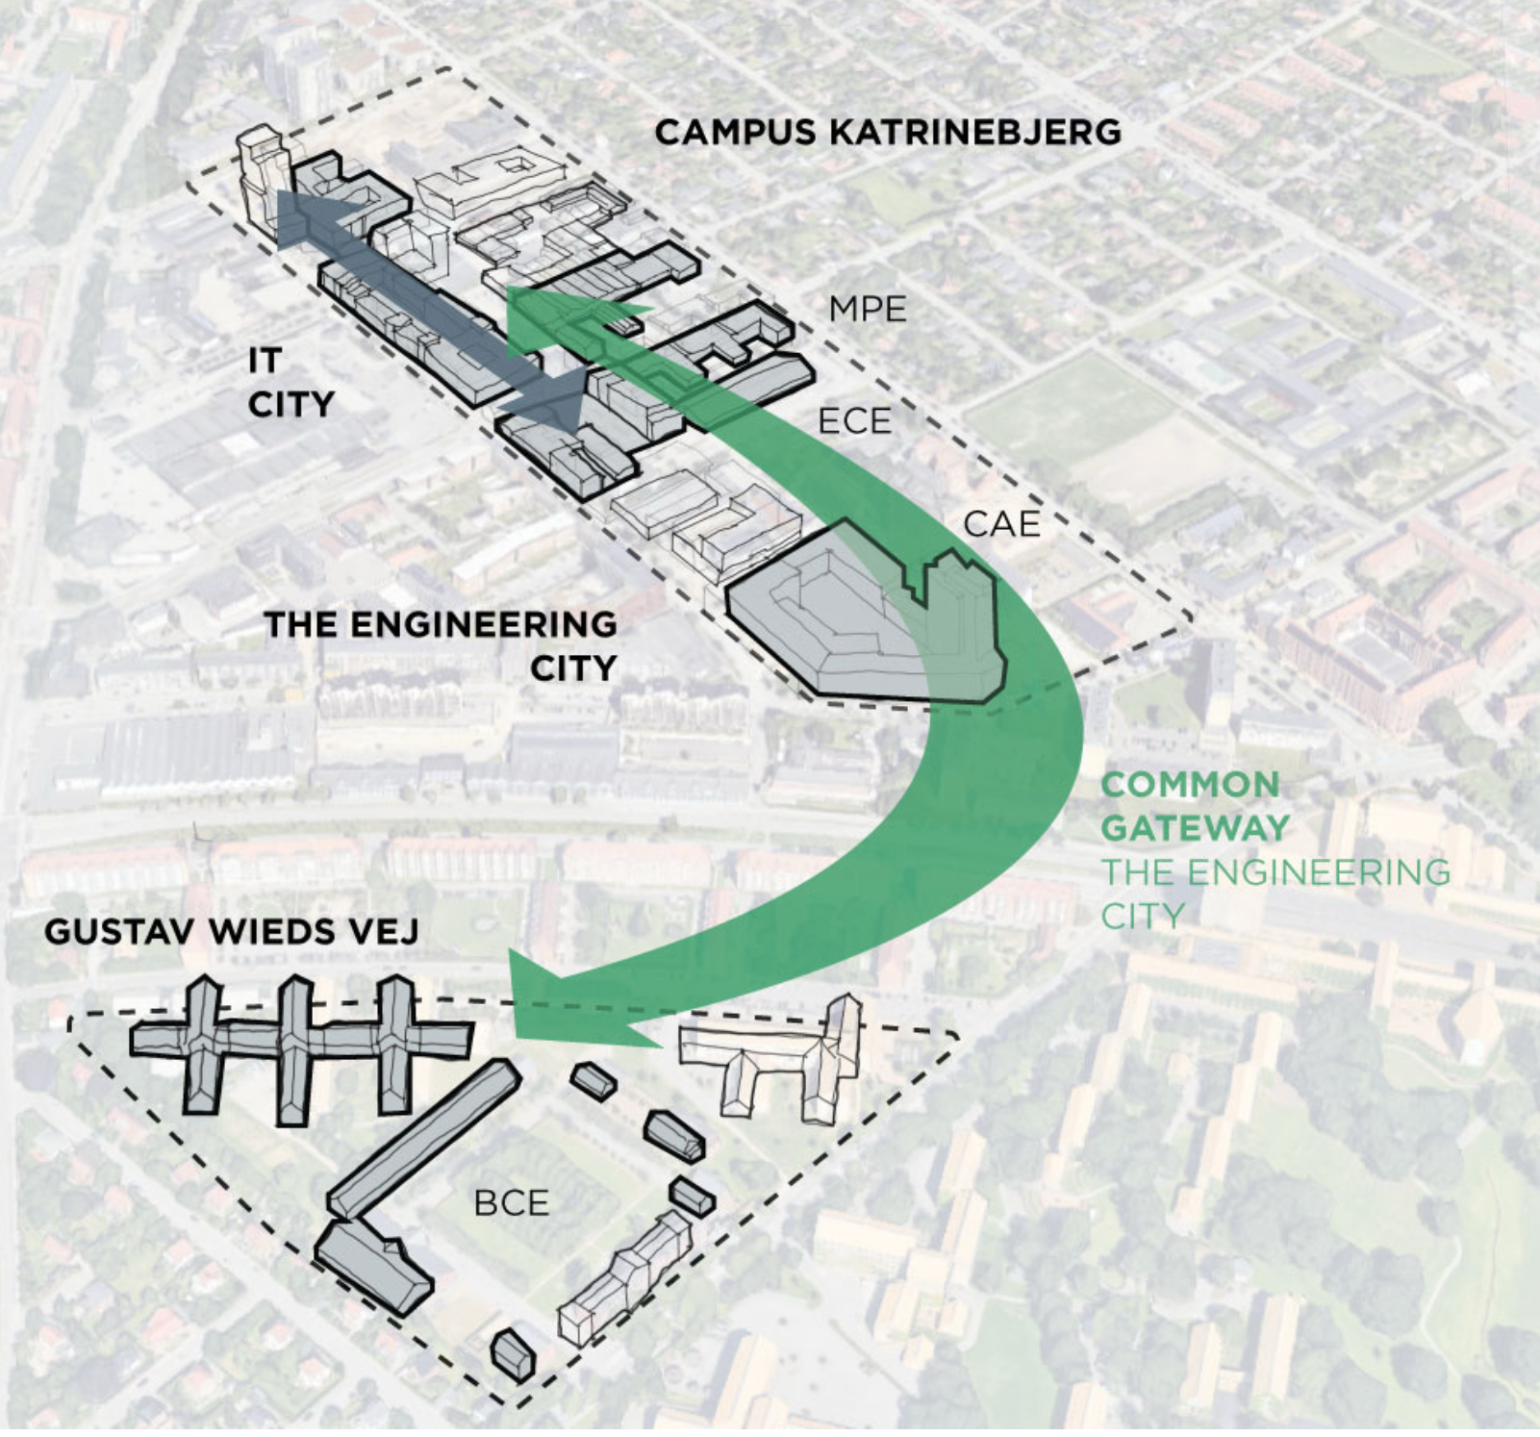
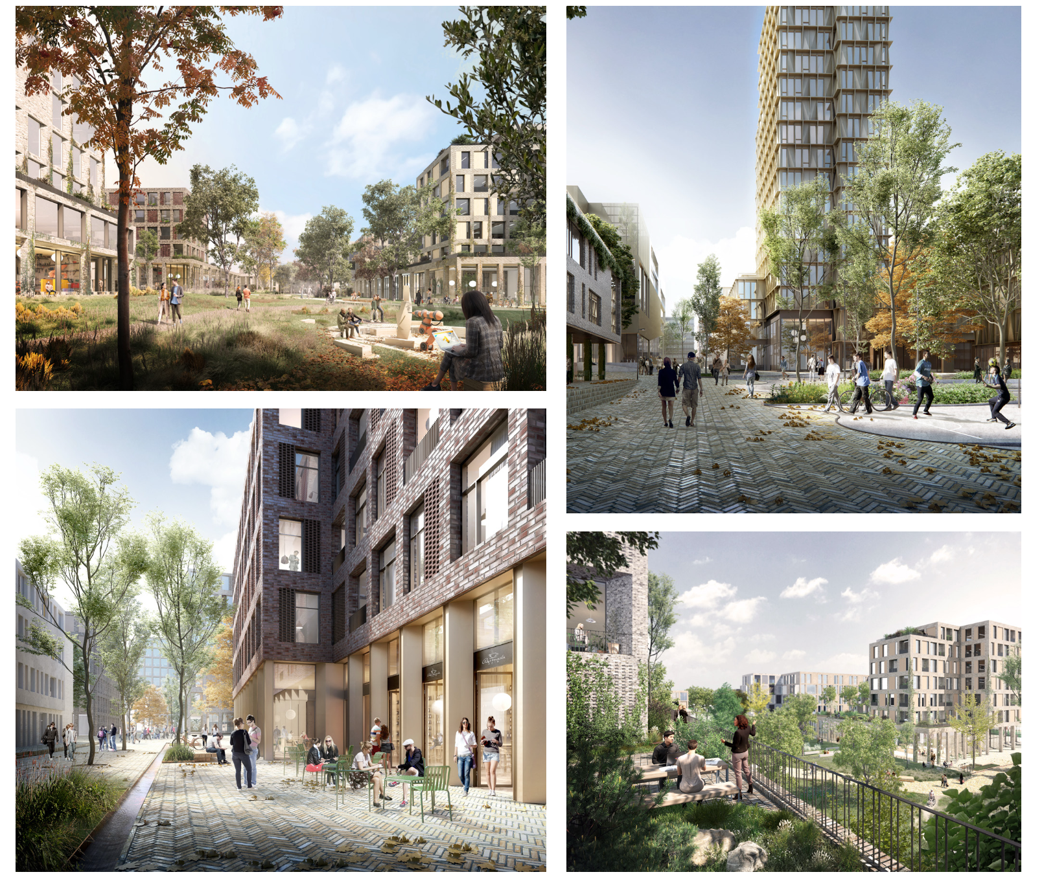
Vision for engineering City 2.0
Notes:
The Vision of the Engineering City sets out seven linked objectives:
The Engineering City is a vibrant destination with a distinct quality, identity, and visibility
The cityscape, landscape, buildings, and indoor spaces of the Engineering City are craf-
ted to foster innovation, connections, and collaboration.
3. We are known for our quality study environments and thriving student population.
4. We are known for our leading research and facilities enabling dynamic, mission-driven
collaborations in a range of fields, such as smart water tech, future production tech, rege-
nerative building, and clean energy tech.
5. Innovation: we are known for our deep technical knowledge within the pillars of our en-
gineering disciplines.
6. Collaboration: we are the leading cluster for interdisciplinary collaborations in technical
science and collaborate internally as well as externally.
7. We are the preferred develop

Slide 5
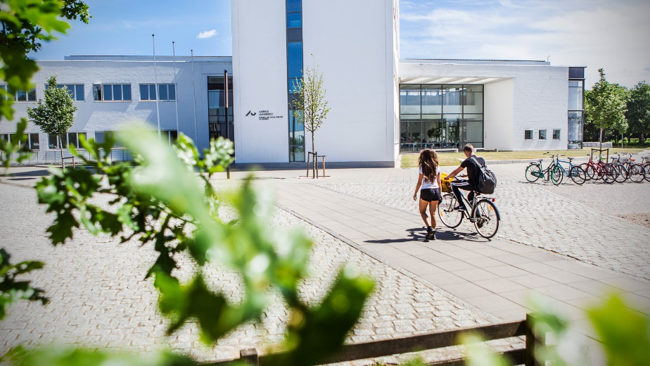
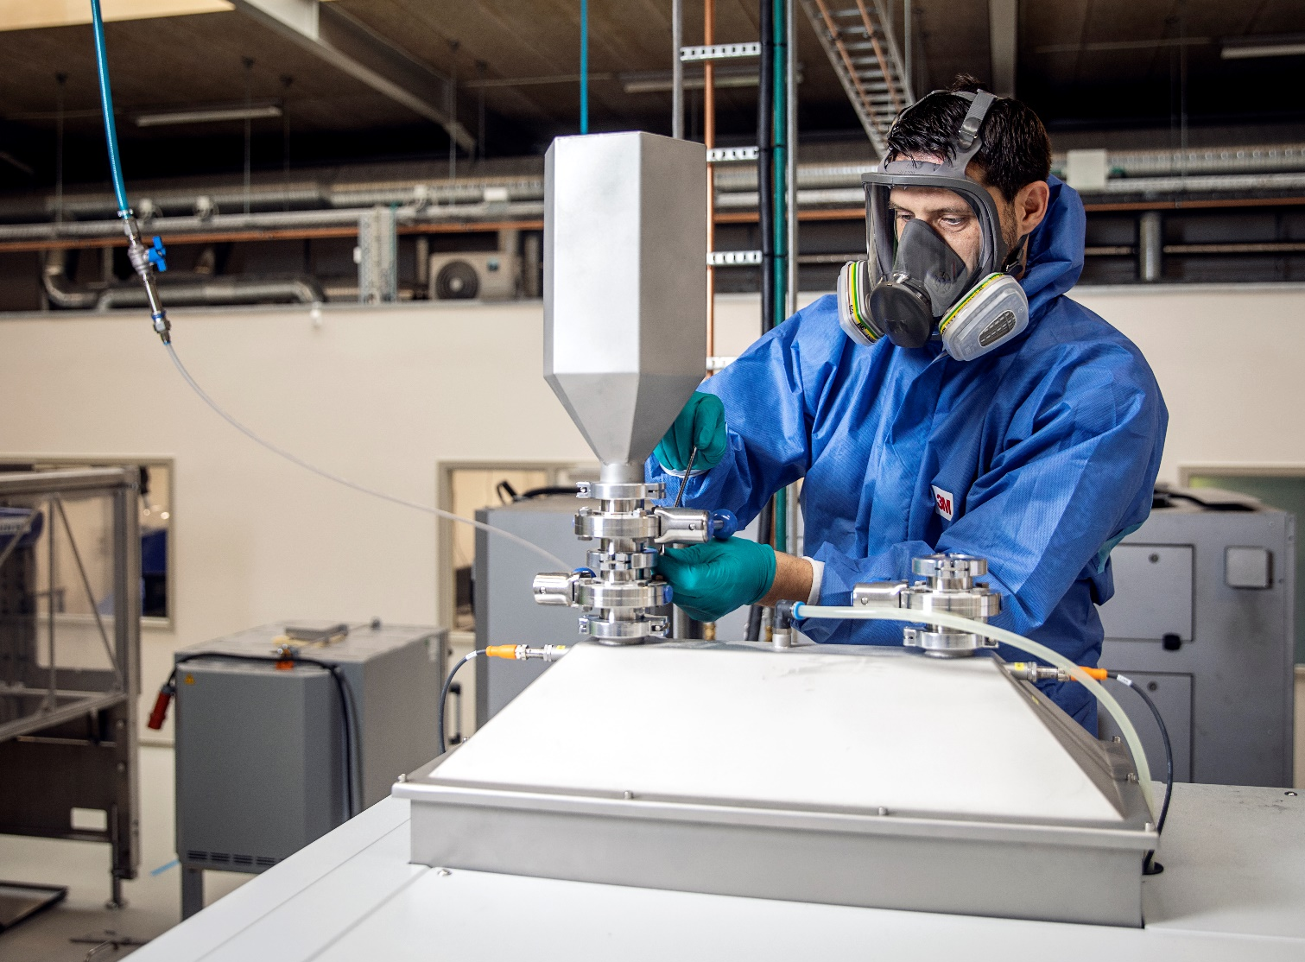
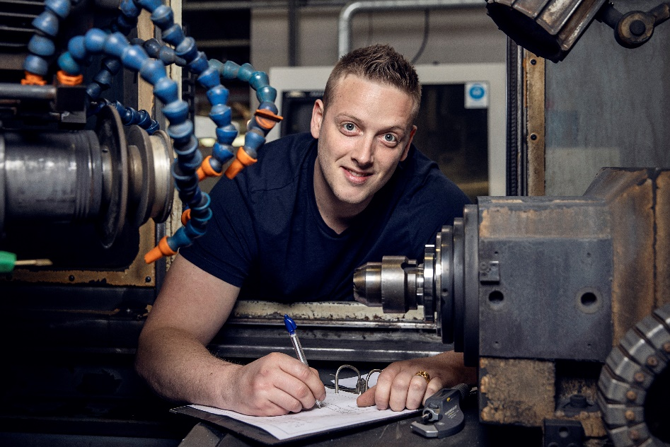
AU Herning

Slide 6
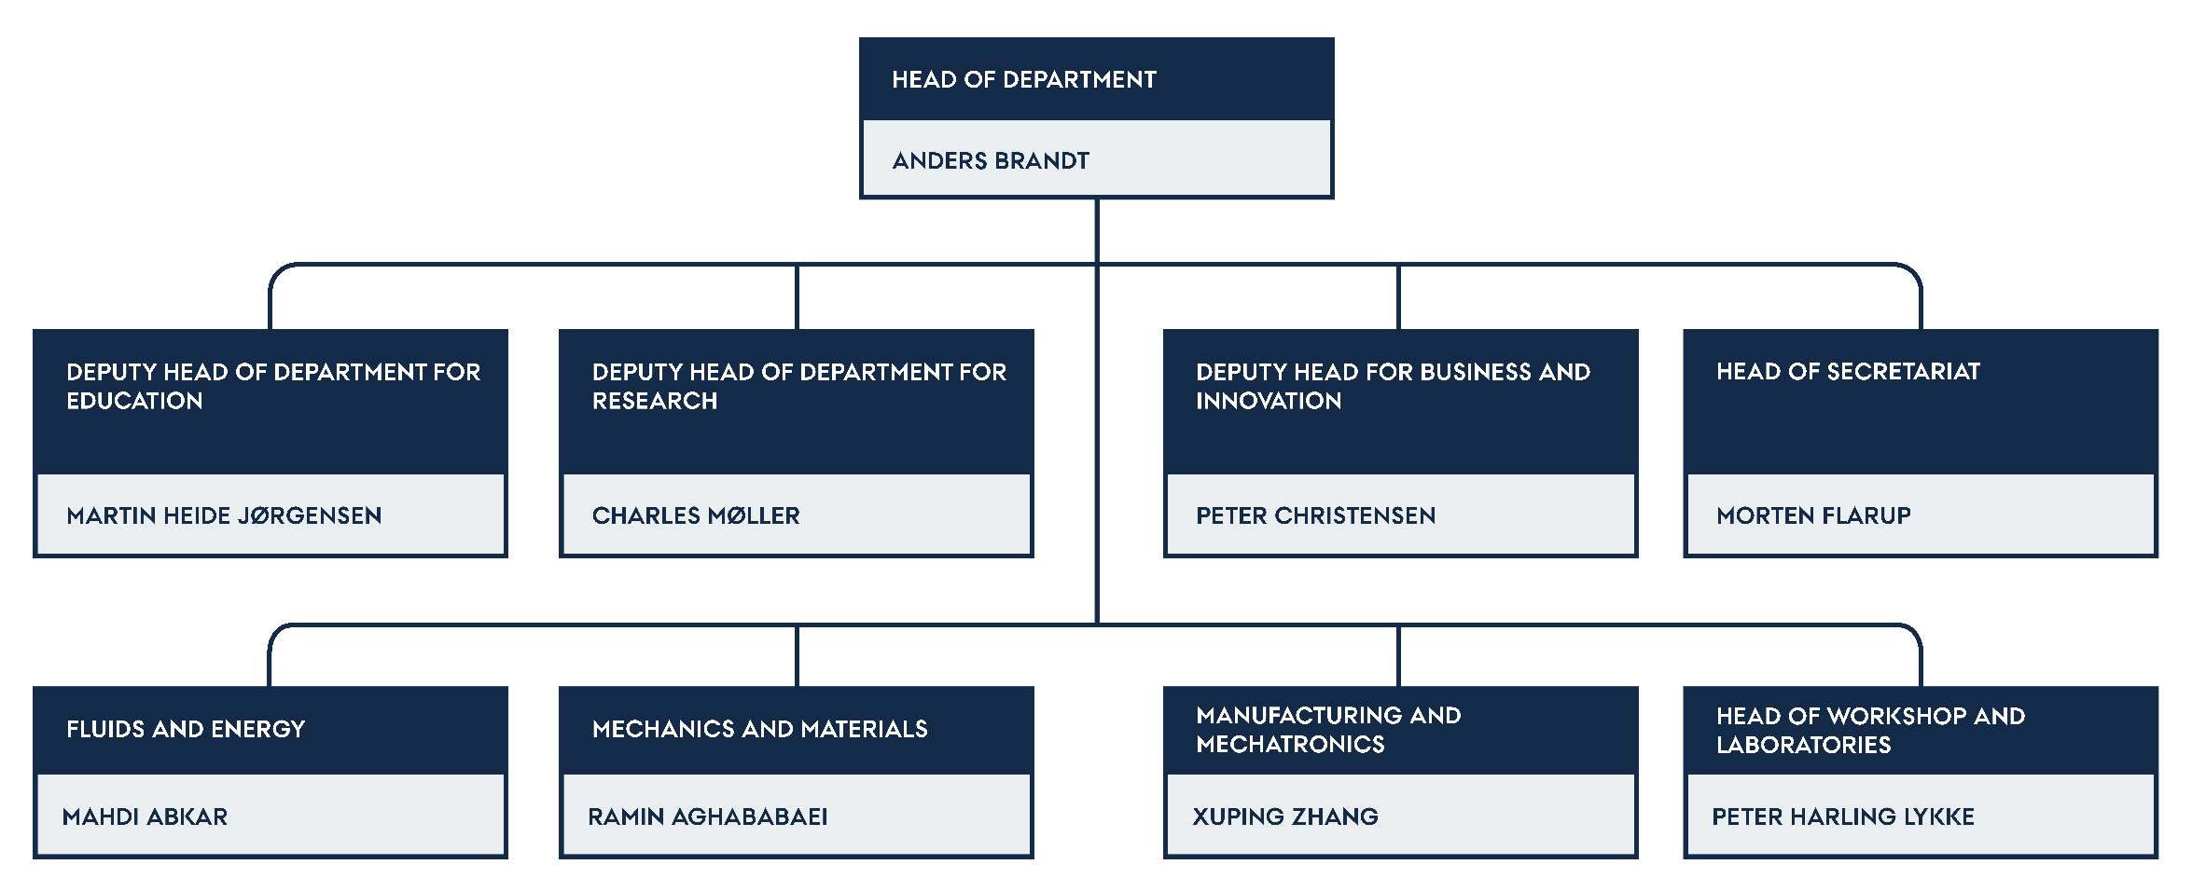
Organisation

Slide 7
The MPE Mission and Vision Towards 2030
Collaboration
Education
Research
Innovation
We create lasting impact by leading the transformation towards a resilient and sustainable industry, society and planet.

Slide 8
Inter-disciplinary Focus Areas
  Making next-generation mechanical products and processes​
    Design and Manufacturing
  Meeting net-zero energy demand
    Energy Systems and Conversion
  Improving human health and quality of life
    Biomechanical Solutions
  Safeguarding sovereignty and safety​
    Defense and Readiness
MEMA
MAME
FLEN
Mechanics and Materials
Manufacturing and Mechatronics
Fluids and Energy

Slide 9




The department in numbers
19 | 29 | 14 | 69
Nationalities | PhD students | Postdocs | Permanent staff

Slide 10



Our students in numbers
835 | 458 | 181 | 196
Total students | Bachelor of Engineering | Bachelor of Science | Master of Science

Slide 11
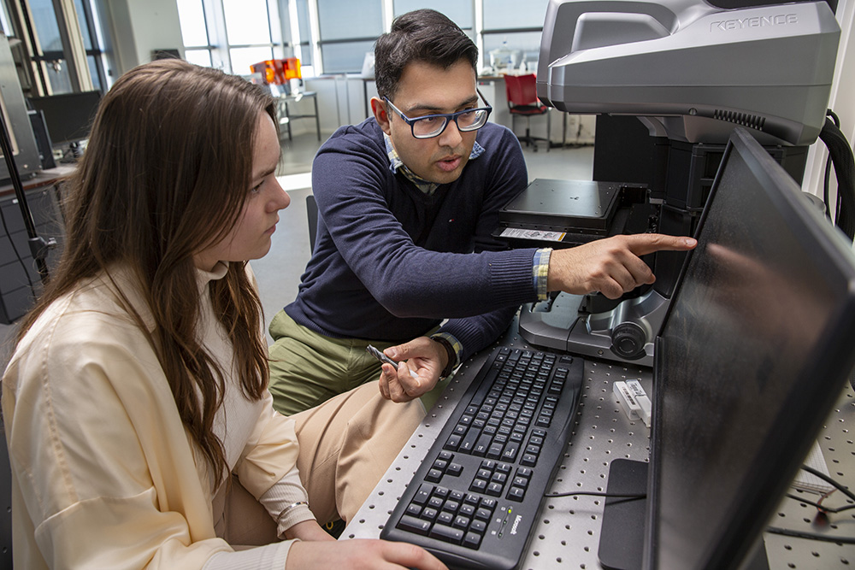
Master of Science in Mechanical Engineering
A Master of Science in Engineering degree programme takes five years. The programme opens the doors to work with innovation and advanced technology, both in companies and at universities. During your studies, you will be taught by researchers, and this will give you access to the very latest knowledge. With an MSc in Engineering, you will be a specialist who can push the limits of what is possible, and you will be able to forge the solutions of tomorrow.

Slide 12
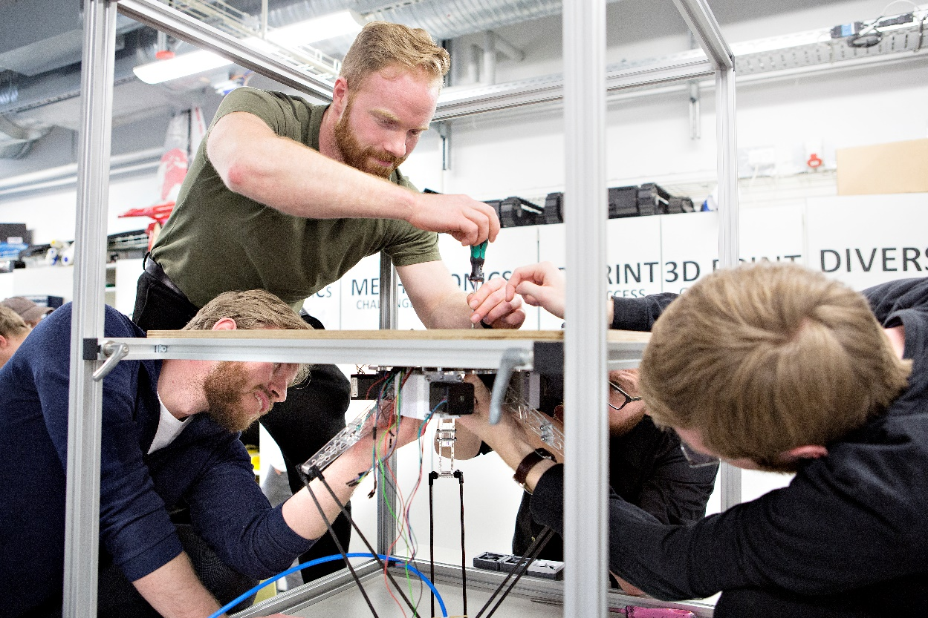
Bachelor of Science in Mechanical Engineering
BSc in Engineering - The 5-year MSc in Engineering starts with the 3-year BSc in Engineering programme (in Danish) that automatically qualifies you for the 2-year MSc in Engineering programme (in English). As a graduate Bachelor of Science in Mechanical Engineering, you also have the option to continue on the Work-integrated Master’s degree programme.

Slide 13
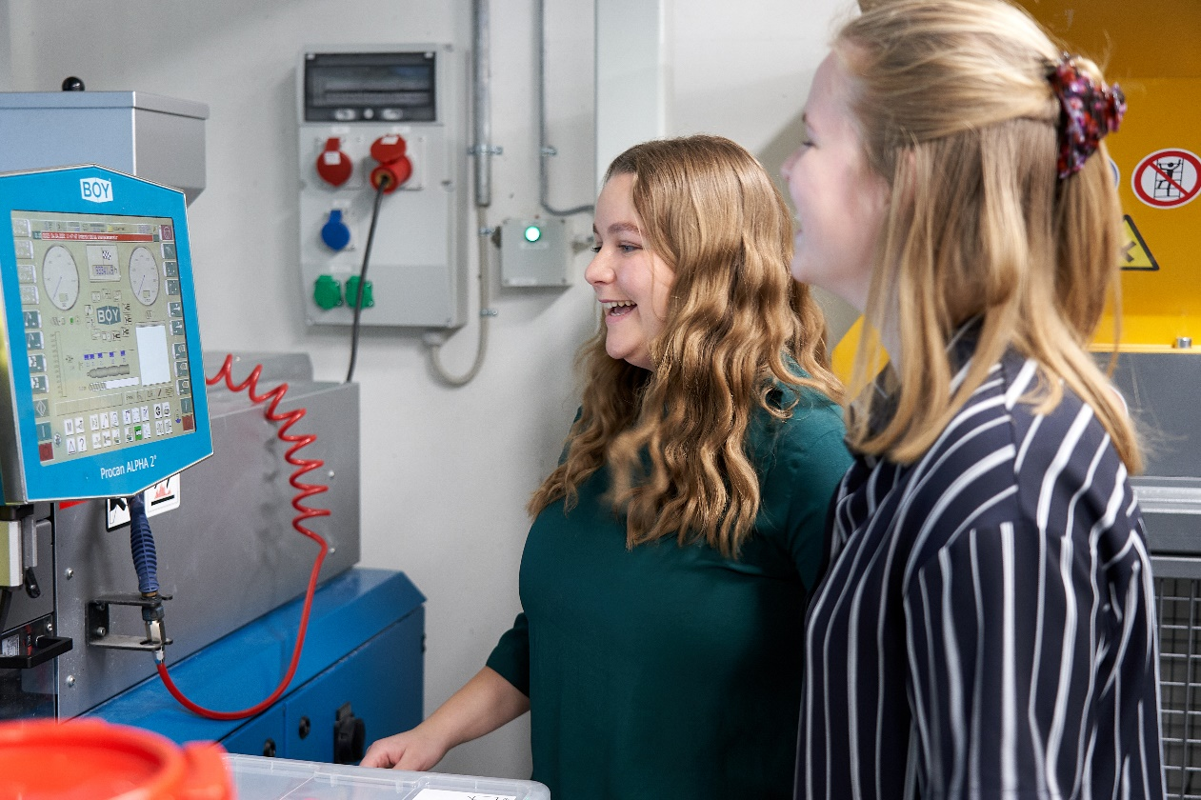
Bachelor of Mechanical Engineering
A Bachelor of Engineering programme takes 3½ years. It is business-oriented and therefore opens the doors to a labour market, where you will be bringing your knowledge of technology into play in many different fields. With a Bachelor of Engineering, you will be able to create solutions to specific challenges to benefit companies and society. With a Bachelor of Engineering, it is also possible to continue to take an MSc in Engineering (+ 2 years) or Work-integrated Master’s degree programme, if you have chosen specific courses during your studies.

Slide 14

Fluids and Energy
The mission of Fluids and Energy section is to support our industrial partners toward the full green transition and digitalization of society in the area of thermo-fluid engineering and energy systems.

Slide 15

Manufacturing and
Mechatronics
The Manufacturing and Mechatronics section brings together multidisciplinary expertise to shape the future of mechatronic and manufacturing systems. By integrating design, modeling, sensing, control, and advanced manufacturing within a full value-chain perspective, the section addresses complex engineering challenges across domains such as robotics, manufacturing and production systems, autonomous platforms, and medical devices.

Slide 16
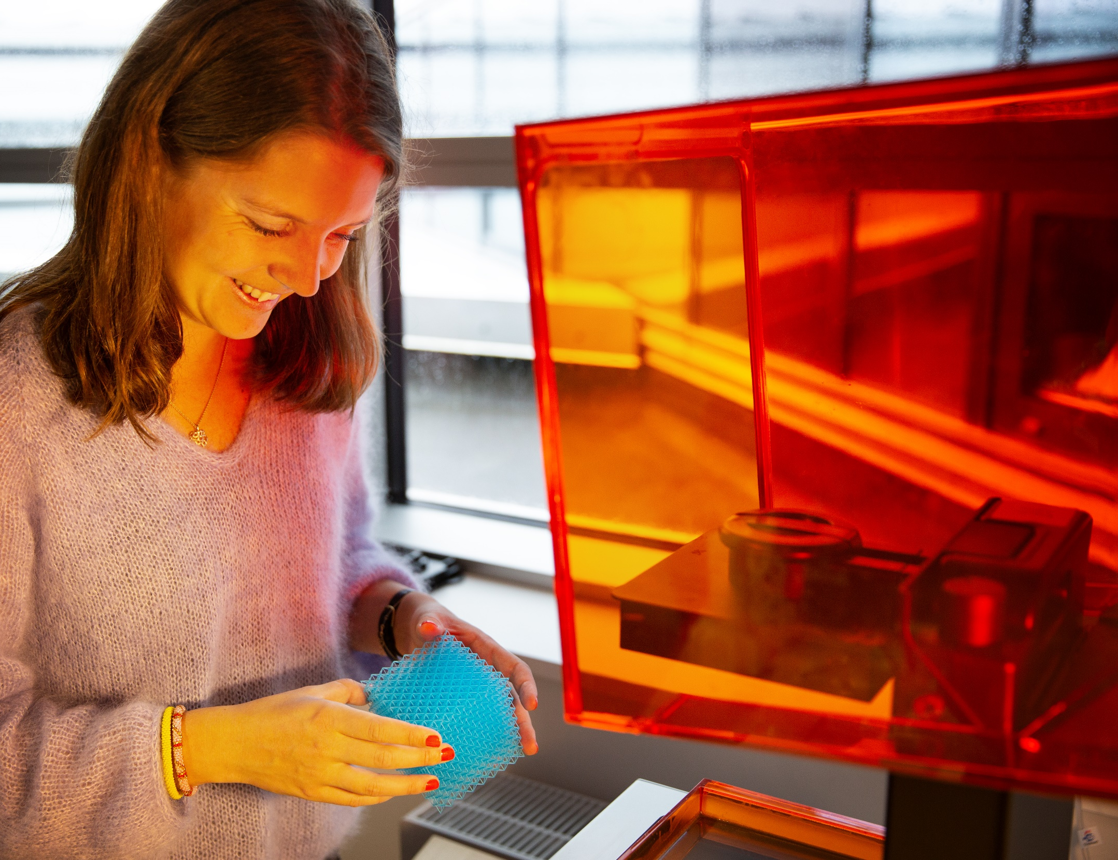

Mechanics and Materials
Section Mechanics and Materials conducts world-class research and teaching in the fields of structural mechanics and material engineering with a focus to minimize material and energy wastes in complex engineering systems.

Slide 17
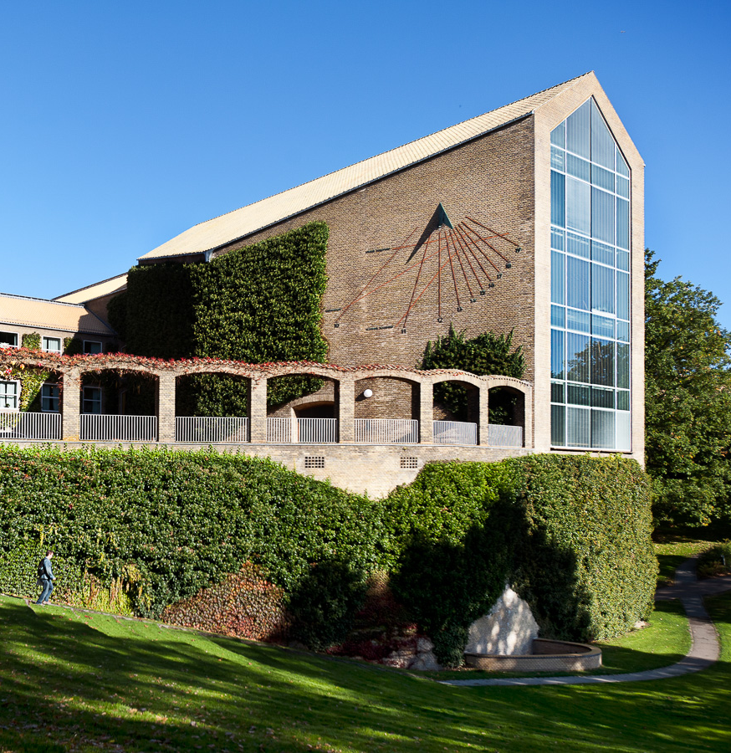
Facts and stats
Aarhus University
With over 50,000 employees
and students, Aarhus University is the size of a provincial Danish city.

Slide 18
Key stats Aarhus University
12,000
Publications
EUR 1 billion
Revenue
580,000 m²
Area (net)
8,500
Employees (FTEs)
38,000
Students, including 1,900 PhD students
4,000
International students
Notes:
Additional facts:
The figures are from 2023 - the latest figures.
With over than 50,000 employees and students, the university is the size of a provincial Danish city.
About one per cent of the country’s population - students and employees - is affiliated with Aarhus University.
In terms of geography, AU covers the equivalent of 83 football pitches, and annual revenues are equivalent to the cost of building a new mega-hospital.
* AU.dk/om/au-i-tal
* The figure ‘International students’ covers international full-degree and part-time students as well as incoming exchange students.

Slide 19

A strong position globally
  In the top 100 on the most influential rankings world-wide.
  6,700 peer reviewed publications (2023)
  Over 10% of AU publications are among the most cited world-wide
  (CWTS Leiden Ranking, 2024)
  2 Nobel Prizes.
  Three international accreditations at Aarhus BSS (AACSB, AMBA, EQUIS).
Notes:
Additional points:
Today, Aarhus University is an offensive player on the international academic playing field.
AU’s placement on the rankings puts the university among the best 0,5 percent of the world’s universities.
Over 10 percent (11.6) of AU’s publications are among the 10 percent most-cited publications in the world.
2 Nobel Prizes – Chemistry (1997) and Economics (2010)
Aarhus BSS has three international accreditations – only about one per cent of the world's business schools have achieved this.

Slide 20
Rankings
(Placement 2024)
Rankings | #
Shanghai Ranking (ARWU) | 80
Leiden Ranking* | 129
National Taiwan University Ranking | 102
QS World University Ranking | 143
Times Higher Education World University Ranking | 110
*Among the world’s largest universities
Notes:
Additional points:
Generally speaking, Aarhus University places high on the most important international rankings.
Among over 17,000 universities world-wide, Aarhus University is ranked in the top 100 by several of the most influential rankings.
A high ranking is an important competitive advantage for a university which seeks to attract and retain the best students, researchers and partners.

