Slide 1
Welcome to Department of mechanical and production engineering

Slide 2
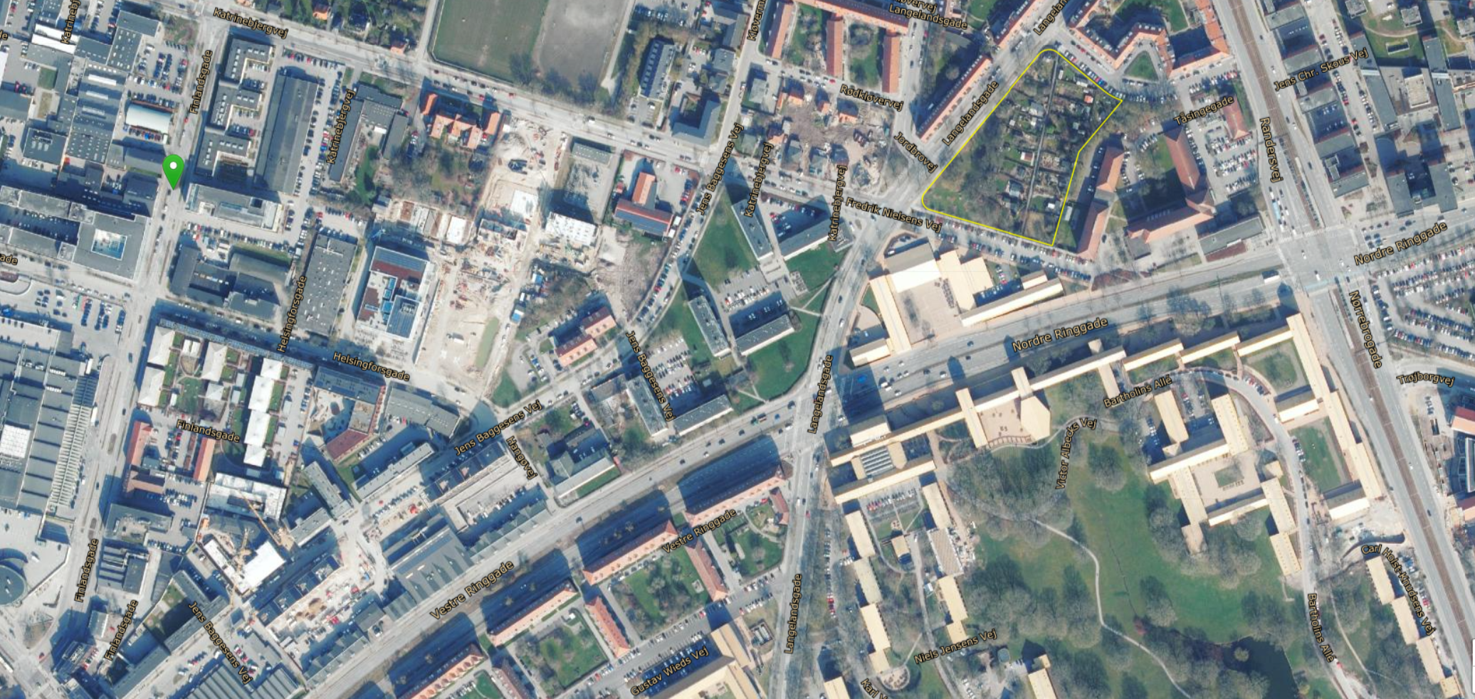
Campus katrinebjerg

Slide 3
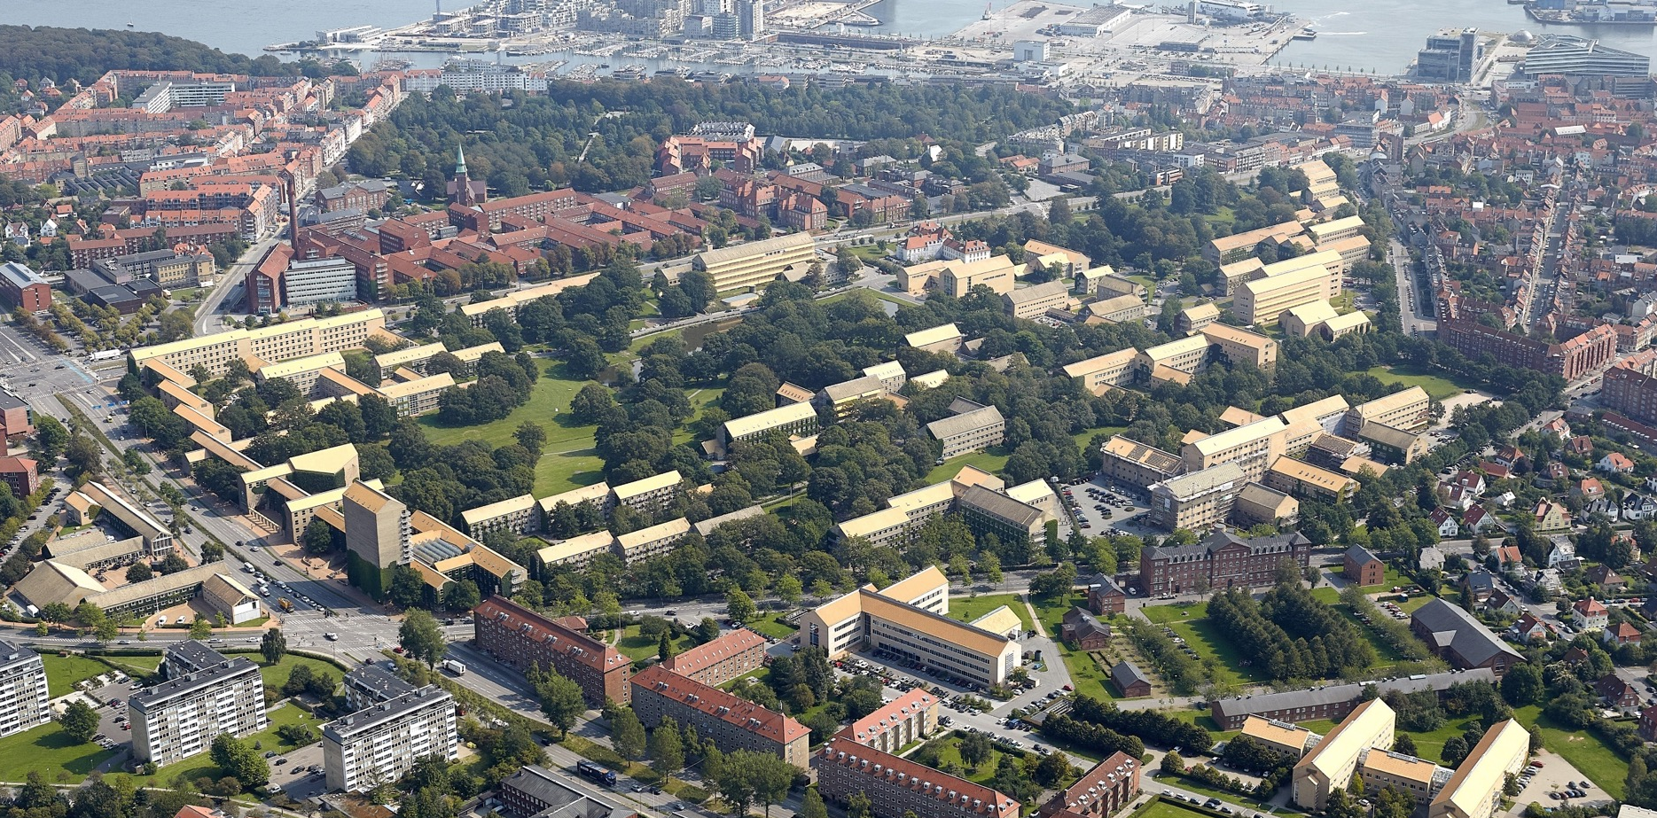
Aarhus university

Slide 4
Vision for engineering City 2.0
Notes:
The Vision of the Engineering City sets out seven linked objectives:
The Engineering City is a vibrant destination with a distinct quality, identity, and visibility
The cityscape, landscape, buildings, and indoor spaces of the Engineering City are craf-
ted to foster innovation, connections, and collaboration.
3. We are known for our quality study environments and thriving student population.
4. We are known for our leading research and facilities enabling dynamic, mission-driven
collaborations in a range of fields, such as smart water tech, future production tech, rege-
nerative building, and clean energy tech.
5. Innovation: we are known for our deep technical knowledge within the pillars of our en-
gineering disciplines.
6. Collaboration: we are the leading cluster for interdisciplinary collaborations in technical
science and collaborate internally as well as externally.
7. We are the preferred develop

Slide 5
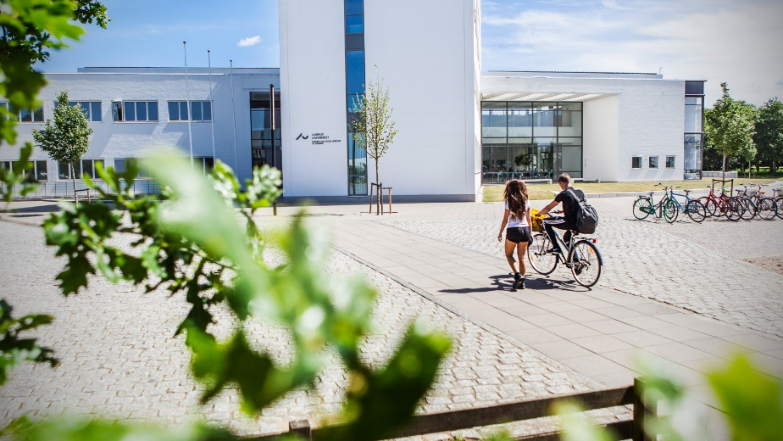
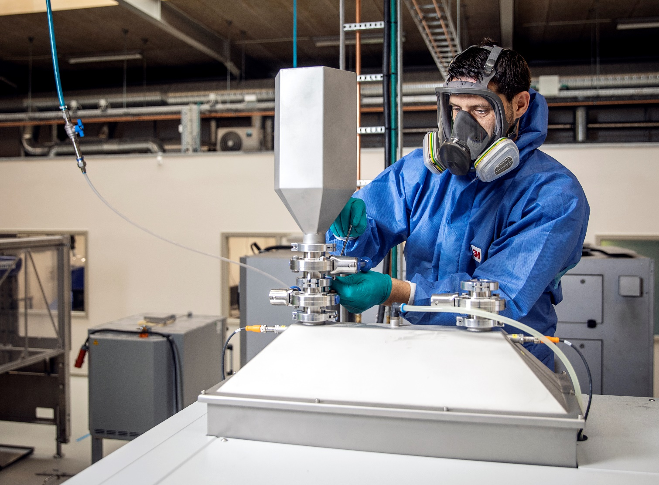
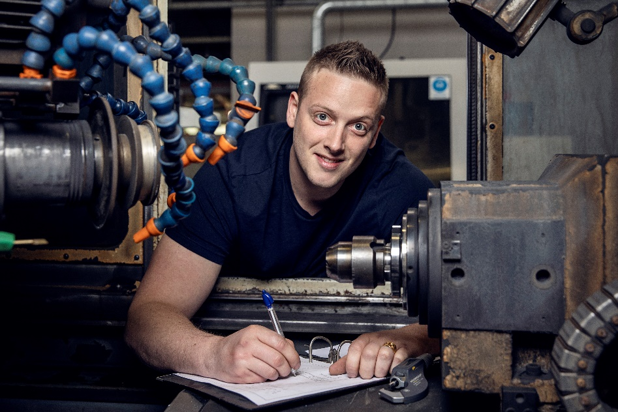
AU Herning

Slide 6
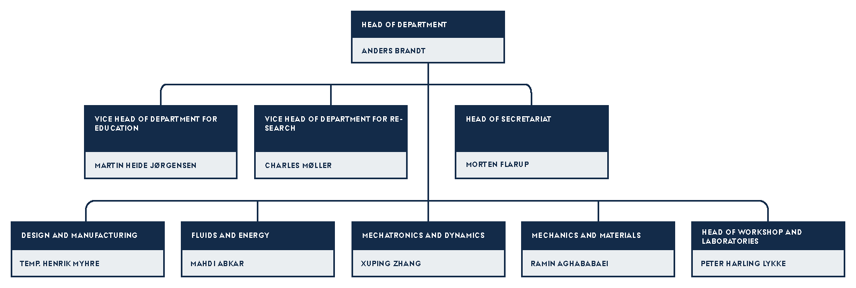
Organization

Slide 7
Vision
Ambition
The Department of Mechanical and Production Engineering makes a difference by solving main industrial and societal challenges through world-class research and teaching
The ambition of the Department of Mechanical and Production Engineering is to transform itself from a young department into an internationally recognized provider of scientific development within the disciplines that design, analyse, produce, control and maintain mechanical systems using technical science, physics, and mathematical modelling.
Equally important, the department aims to be known for its ability to understand the current and future needs of society and adapt its educational programmes accordingly to produce graduates with theoretical knowledge and applied skillset who have the will to make a positive contribution to society through their work as engineers.

Slide 8
Focus Areas
Green Transition | Digitalisation | Biomechanical Engineering
We are working to improve our climate modelling, the efficiency of our energy systems and to develop new low-carbon-emission energy generation processes. Together with companies we are also exploring new green manufacturing strategies. | We are developing new technologies and computational methods for characterizing, predicting and simulating physical events and engineering systems. Our research has a very broad scientific and industrial potential, and applications range from studying nano-scale material physics to improving smart factories. | We are working to understand the extreme complexity of living systems and improve human health from a mechanical perspective. Our research ranges from studying how cells interact to designing new medical equipment for hospitals, for advanced diagnostic approaches and treatment methods.

Slide 11
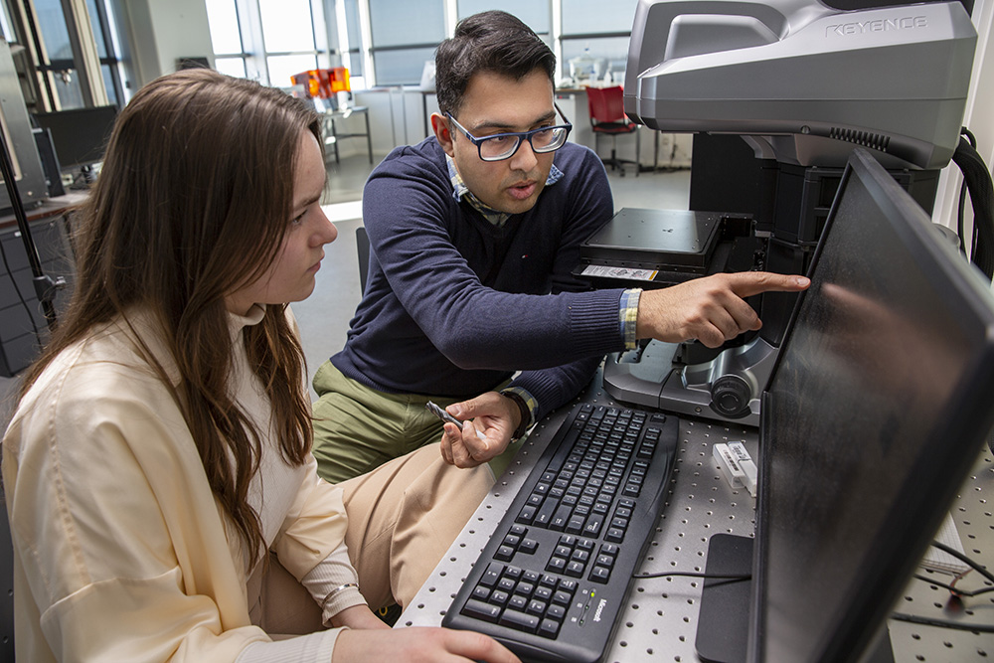
Master of Science in Mechanical Engineering
A Master of Science in Engineering degree programme takes five years. The programme opens the doors to work with innovation and advanced technology, both in companies and at universities. During your studies, you will be taught by researchers, and this will give you access to the very latest knowledge. With an MSc in Engineering, you will be a specialist who can push the limits of what is possible, and you will be able to forge the solutions of tomorrow.

Slide 12
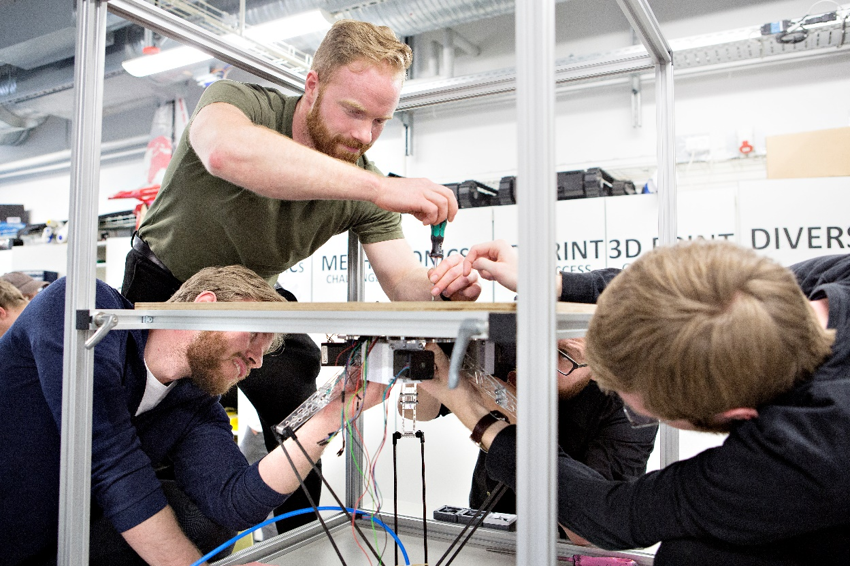
Bachelor of Science in Mechanical Engineering
BSc in Engineering - The 5-year MSc in Engineering starts with the 3-year BSc in Engineering programme (in Danish) that automatically qualifies you for the 2-year MSc in Engineering programme (in English). As a graduate Bachelor of Engineering, you also have the option to continue on the 2-year MSc in Engineering programme. If you want to pursue the 2-year MSc programme, you must make sure to follow specific courses in your bachelor programme.

Slide 13
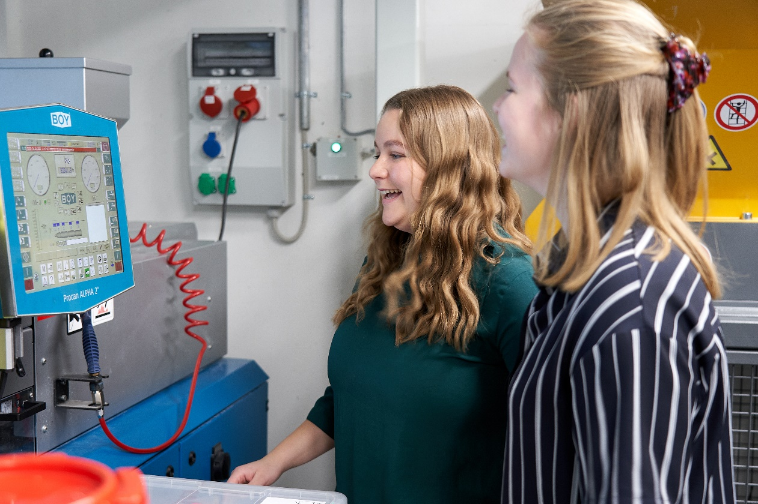
Bachelor of Mechanical Engineering
A Bachelor of Engineering programme takes 3½ years. It is business-oriented and therefore opens the doors to a labour market, where you will be bringing your knowledge of technology into play in many different fields. With a Bachelor of Engineering, you will be able to create solutions to specific challenges to benefit companies and society. With a Bachelor of Engineering, it is also possible to continue to take an MSc in Engineering (+ 2 years), if you have chosen specific courses during your studies.

Slide 14
Design and Manufacturing
Research, innovation, and education on product and process engineering for industrial and societal transition.

Slide 15
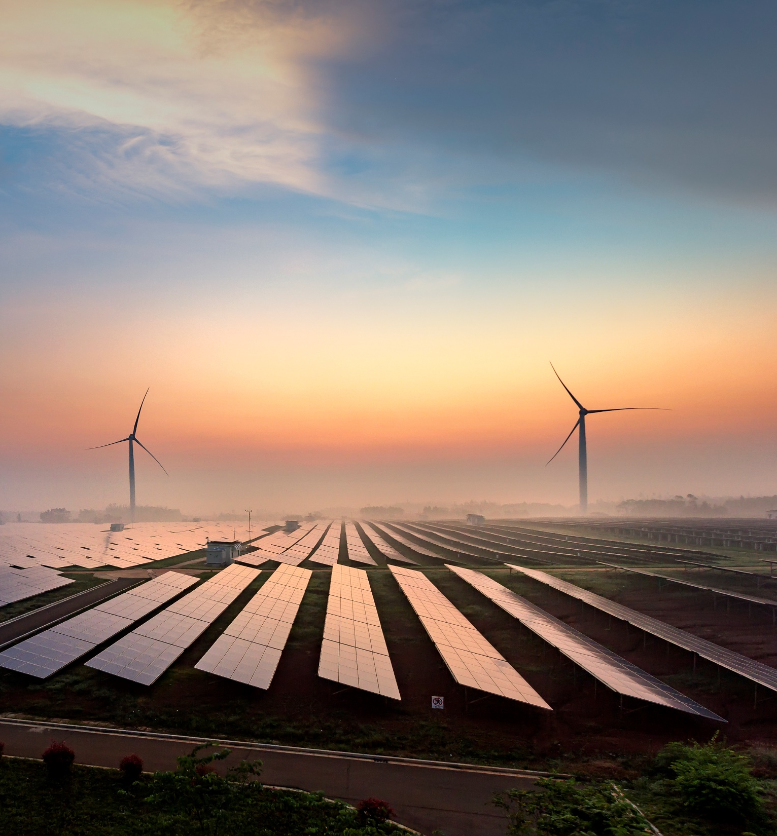
Fluids and Energy
The mission of Fluids and Energy section is to support our industrial partners toward the full green transition and digitalization of society in the area of thermo-fluid engineering and energy systems.

Slide 16
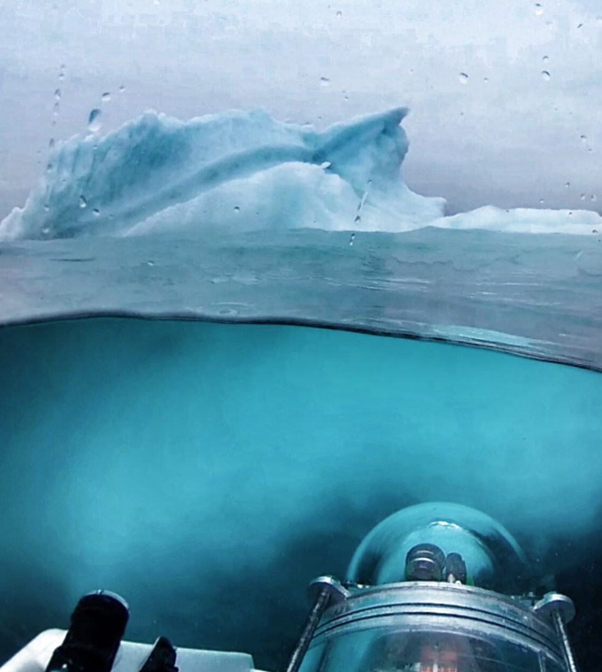
Mechatronics and Dynamics
Mechatronics and Dynamics Section seeks to integrate our specialists and students, and aims to conduct outstanding education and groundbreaking research in the design, modelling and identification, optimization, sensing, actuation, control, system integration, and implementation of intelligent mechatronic systems, such as robots, mechanical machines, wind turbines, ground vehicles, drones, underwater vehicles, medical devices

Slide 17
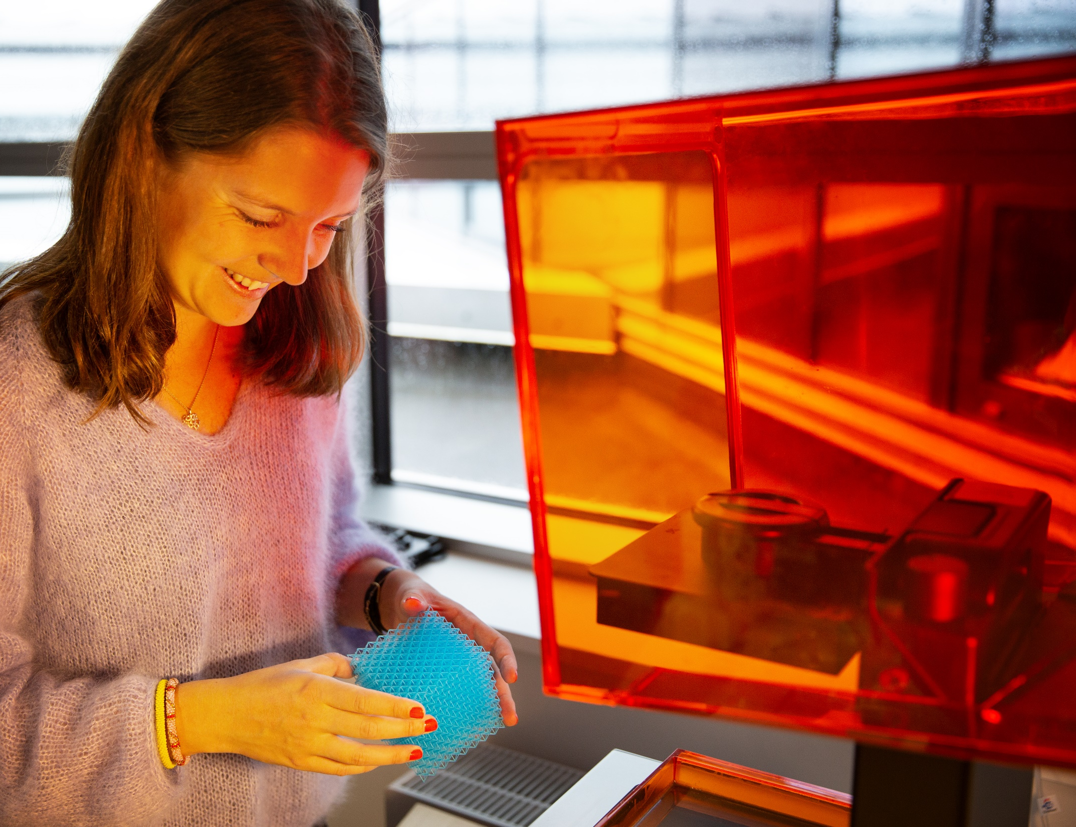
Mechanics and Materials
Section Mechanics and Materials conducts world-class research and teaching in the fields of structural mechanics and material engineering with a focus to minimize material and energy wastes in complex engineering systems.

Slide 18
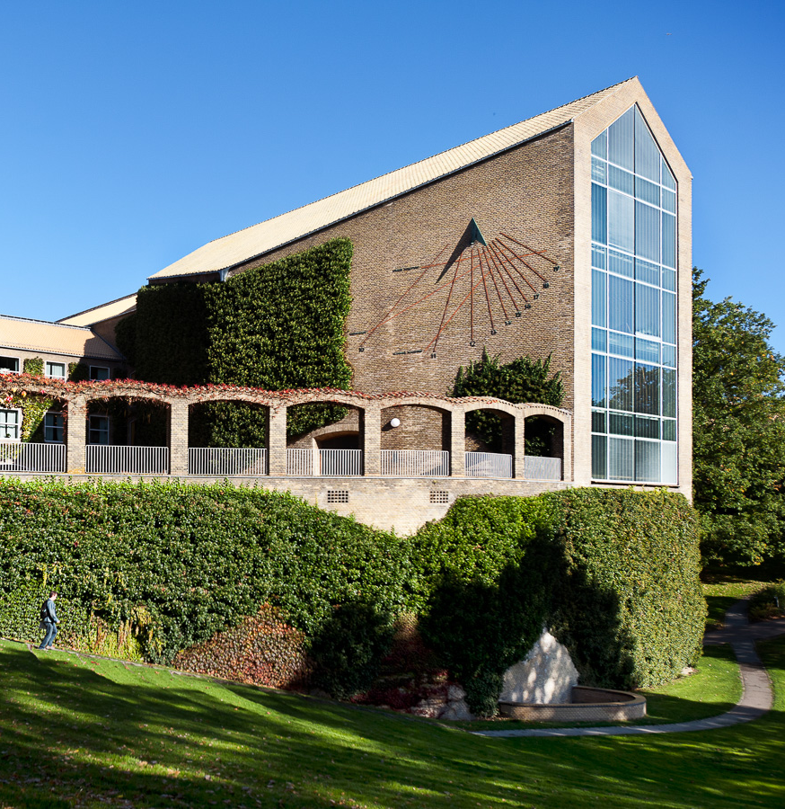
Facts and stats Aarhus University
With over 50,000 employees
and students, Aarhus University is the size of a provincial Danish city.

Slide 19
Key stats Aarhus University
12,000
Publications
EUR 1 billion
Revenue
580,000 m² Area (net)
8,500
Employees (FTEs)
38,000
Students, including 1,900 PhD students
4,000 International students
Notes:
Additional facts:
The figures are from 2023 - the latest figures.
With over than 50,000 employees and students, the university is the size of a provincial Danish city.
About one per cent of the country’s population - students and employees - is affiliated with Aarhus University.
In terms of geography, AU covers the equivalent of 83 football pitches, and annual revenues are equivalent to the cost of building a new mega-hospital.
* AU.dk/om/au-i-tal
* The figure ‘International students’ covers international full-degree and part-time students as well as incoming exchange students.

Slide 20
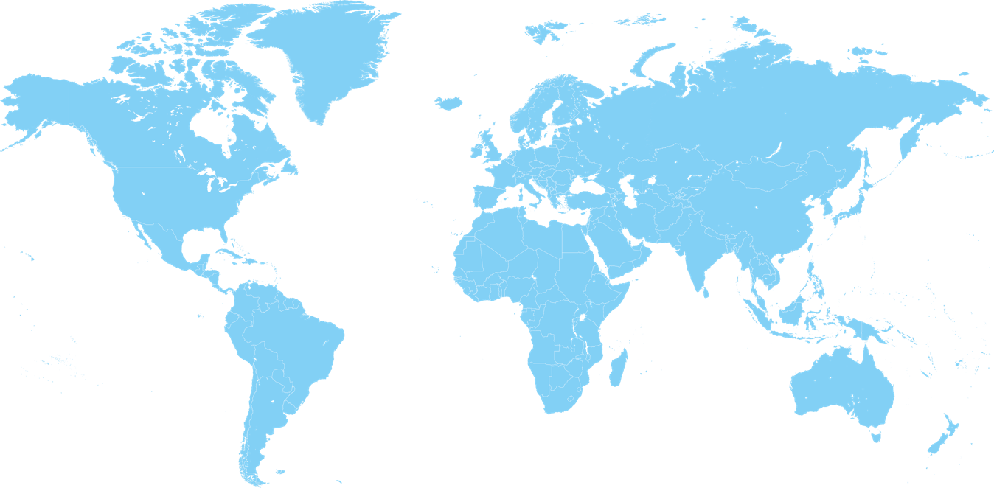
A strong position globally
In the top 100 on the most influential rankings world-wide.
6,700 peer reviewed publications (2023)
Over 10% of AU publications are among the most cited world-wide (CWTS Leiden Ranking, 2024)
2 Nobel Prizes.
Three international accreditations at Aarhus BSS (AACSB, AMBA, EQUIS).
Notes:
Additional points:
Today, Aarhus University is an offensive player on the international academic playing field.
AU’s placement on the rankings puts the university among the best 0,5 percent of the world’s universities.
Over 10 percent (11.6) of AU’s publications are among the 10 percent most-cited publications in the world.
2 Nobel Prizes – Chemistry (1997) and Economics (2010)
Aarhus BSS has three international accreditations – only about one per cent of the world's business schools have achieved this.

Slide 21
Rankings (Placement 2024)
Rankings | #
Shanghai Ranking (ARWU) | 80
Leiden Ranking* | 129
National Taiwan University Ranking | 102
QS World University Ranking | 143
Times Higher Education World University Ranking | 110
*Among the world’s largest universities
Notes:
Additional points:
Generally speaking, Aarhus University places high on the most important international rankings.
Among over 17,000 universities world-wide, Aarhus University is ranked in the top 100 by several of the most influential rankings.
A high ranking is an important competitive advantage for a university which seeks to attract and retain the best students, researchers and partners.

